Slide 1
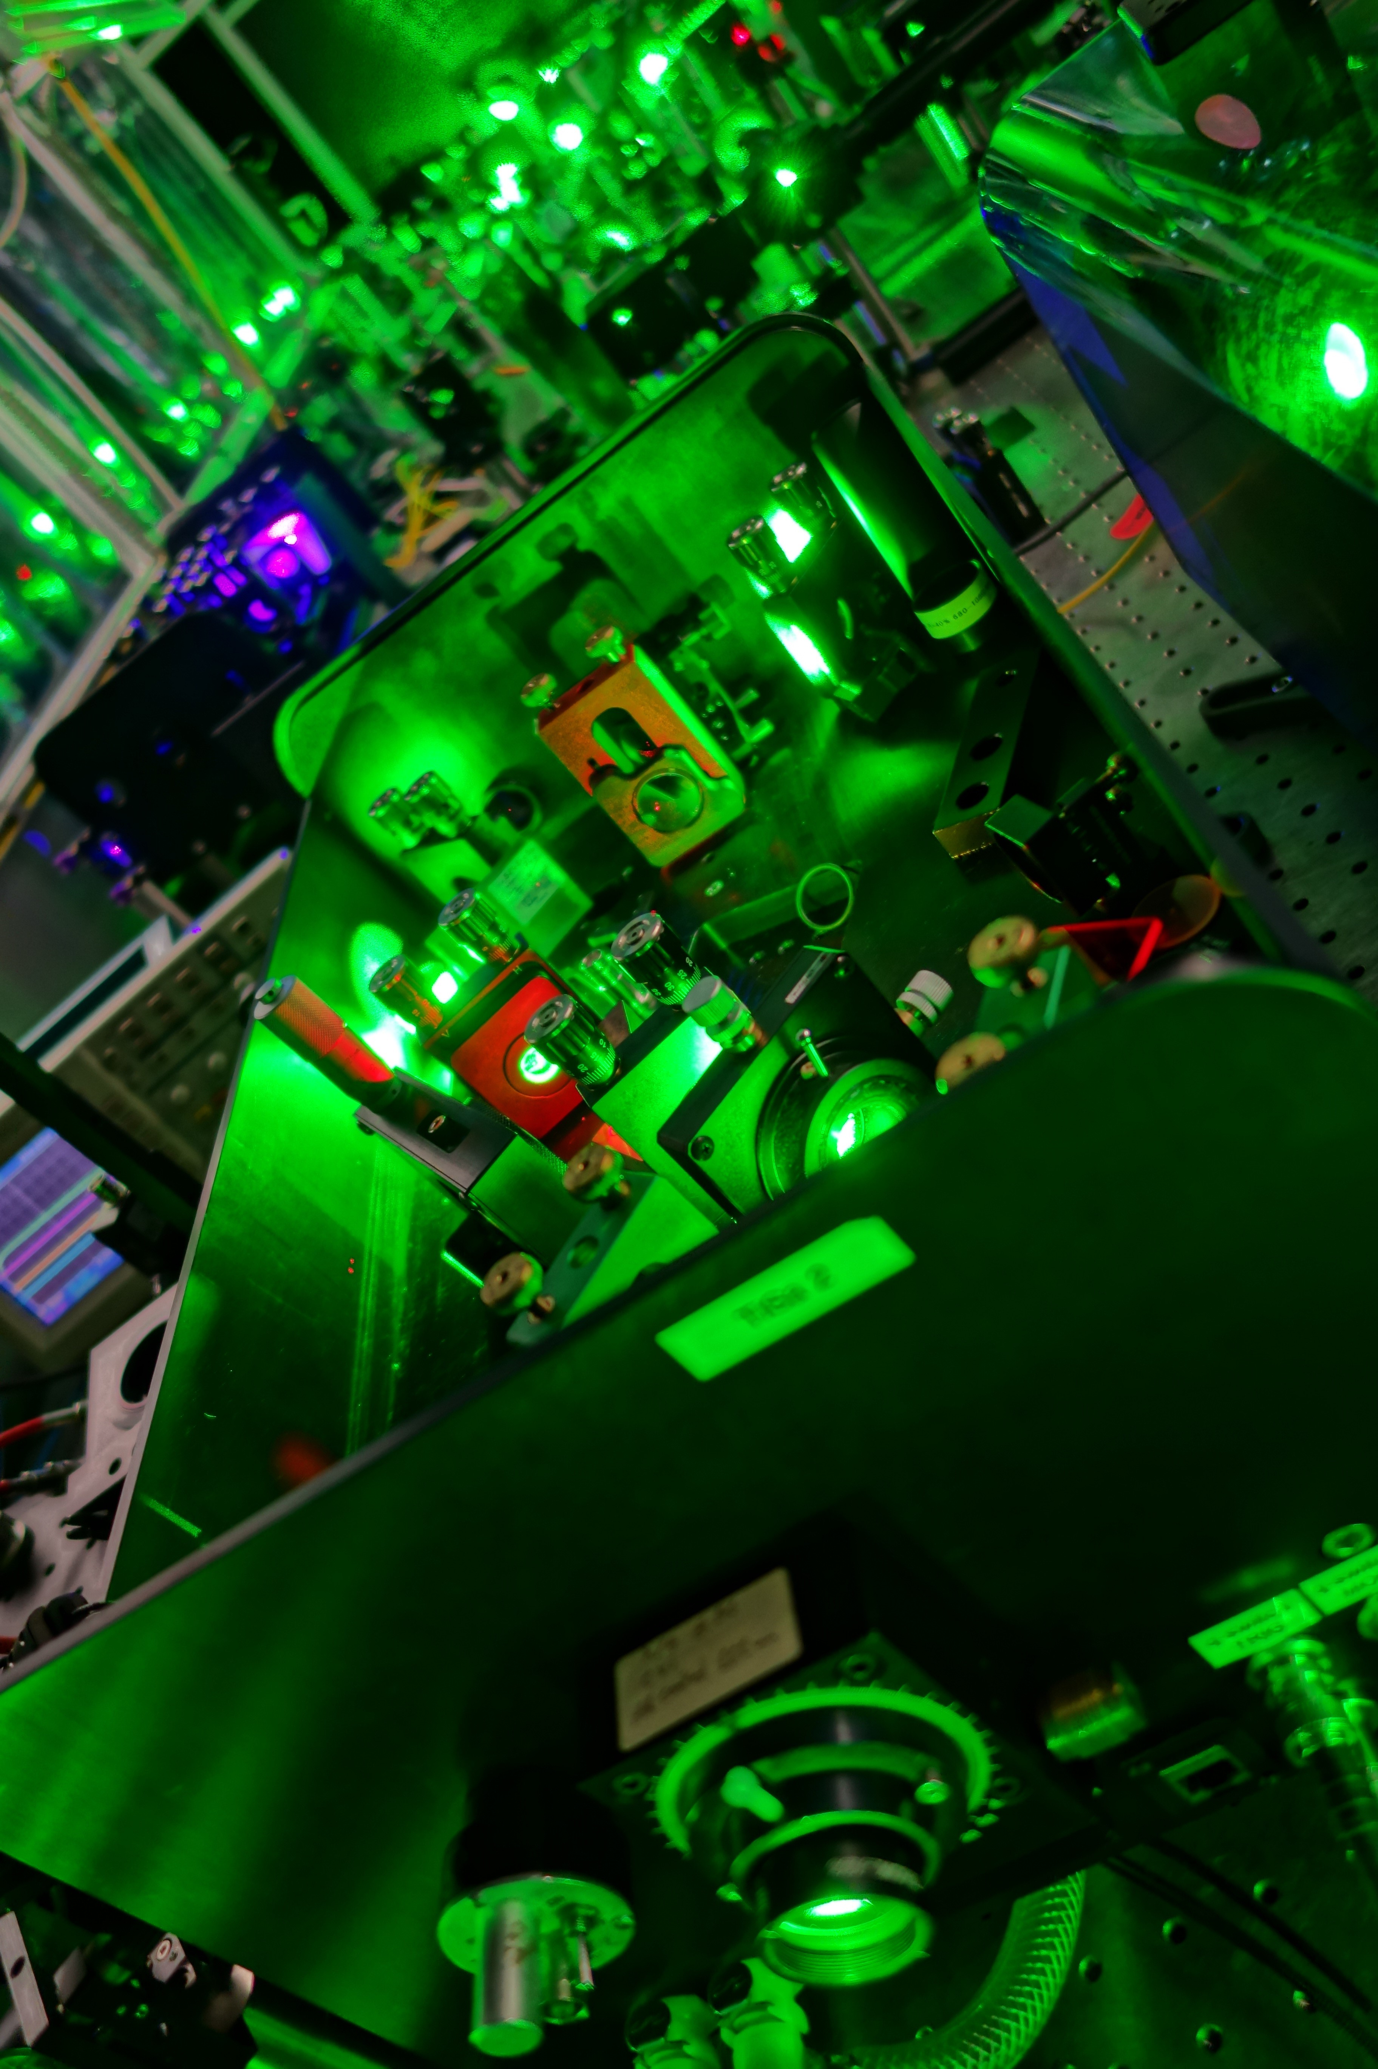




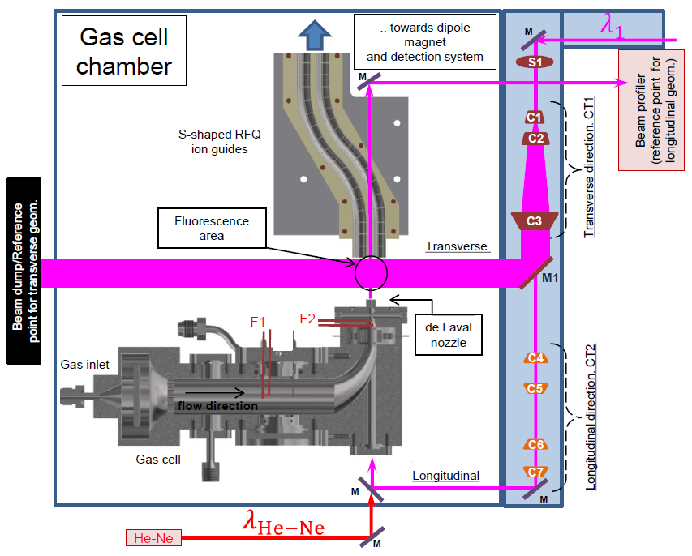
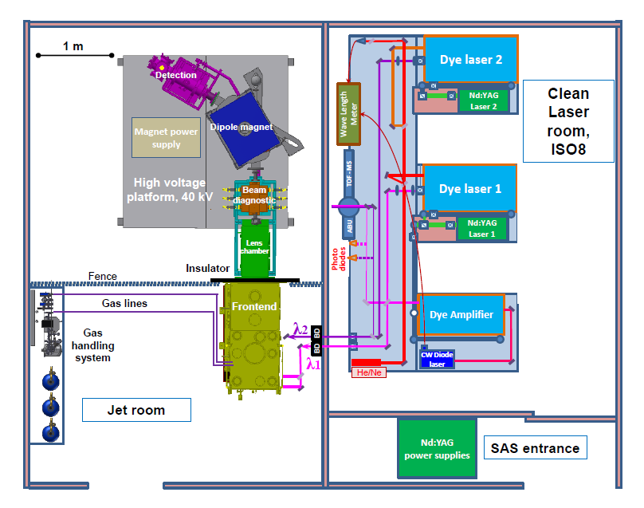
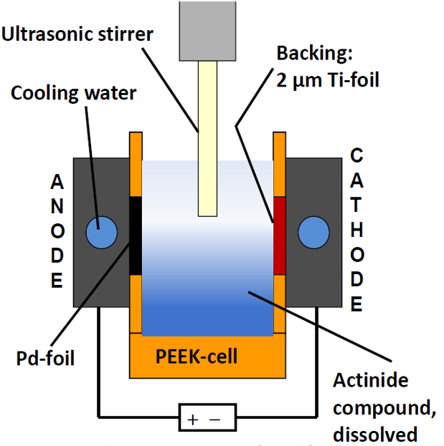
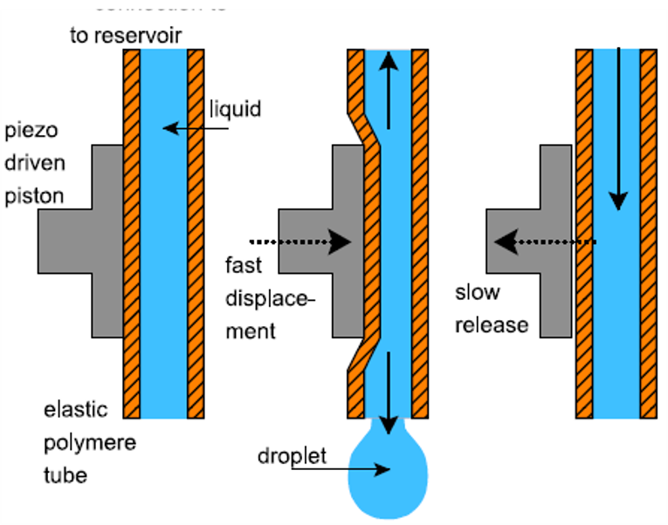
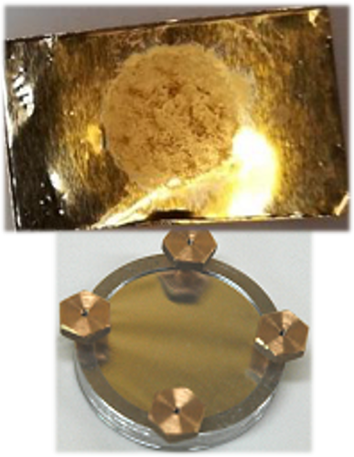
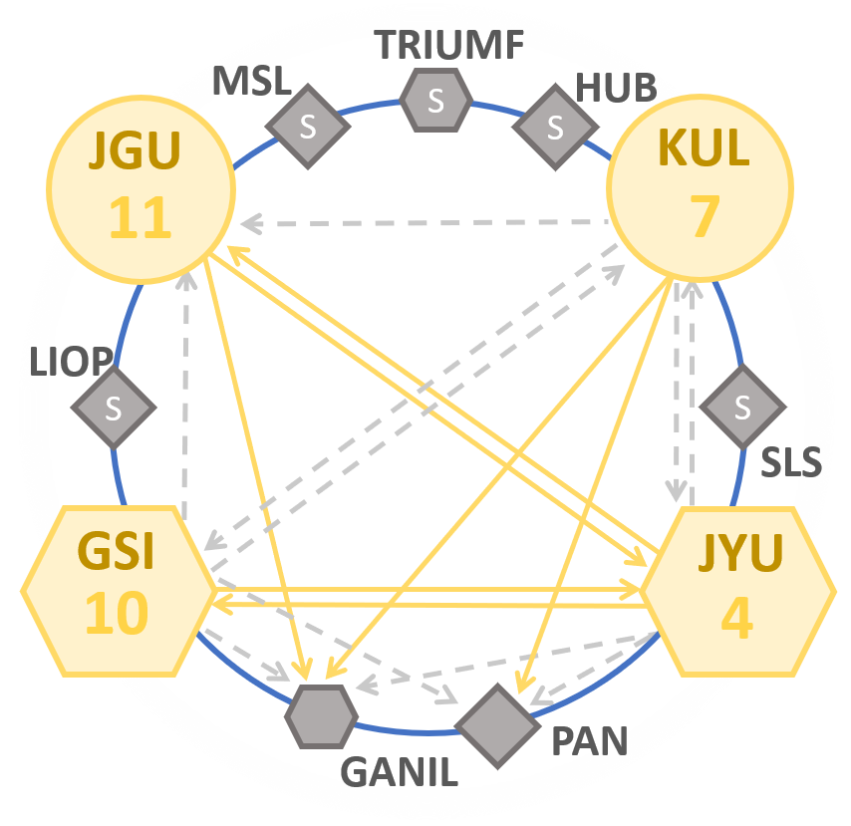
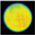
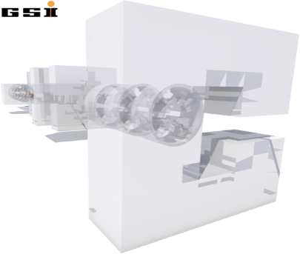
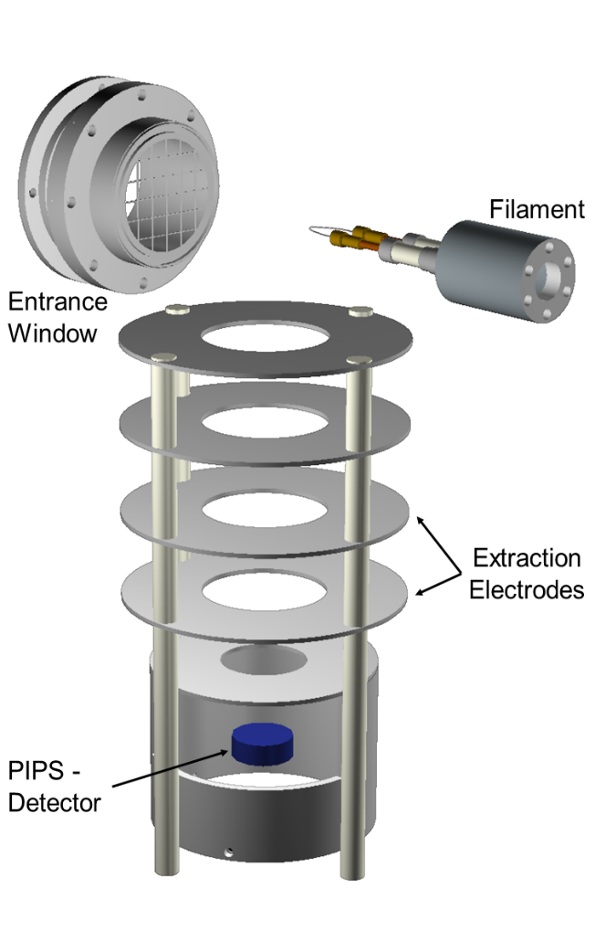


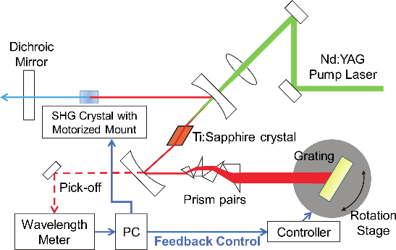
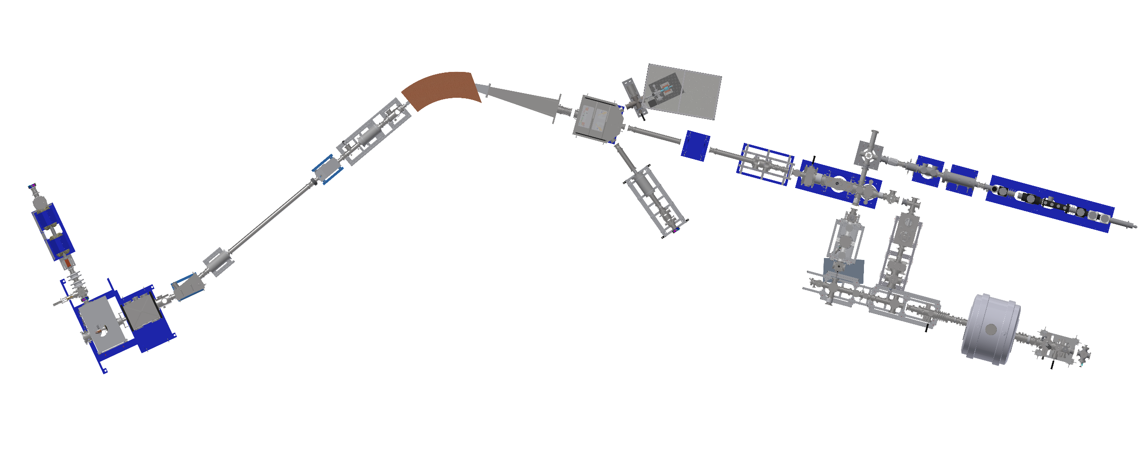
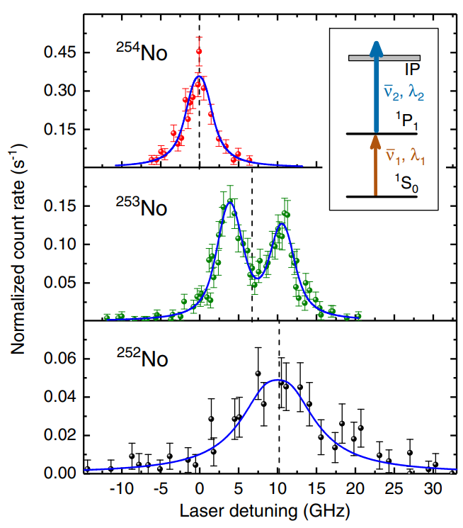
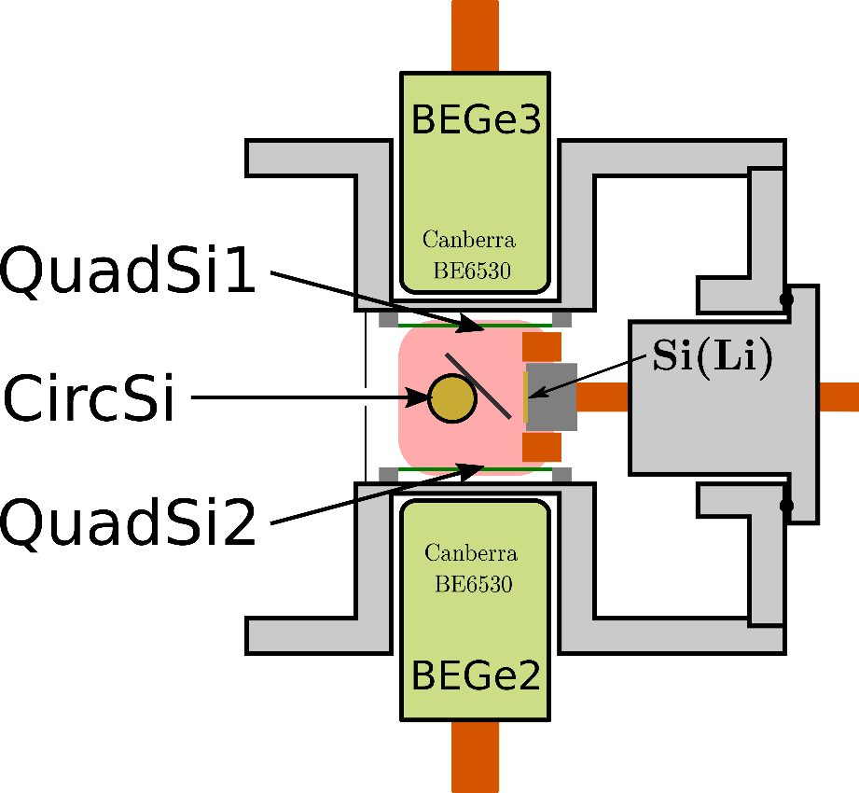
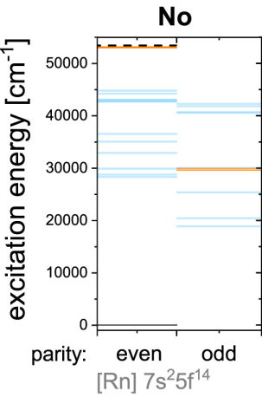
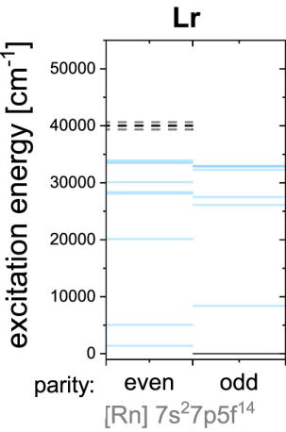

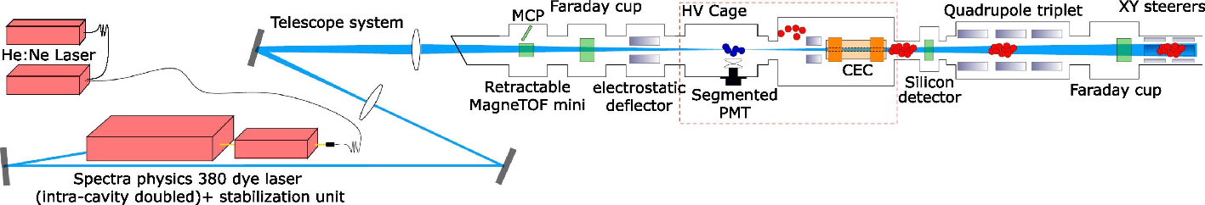
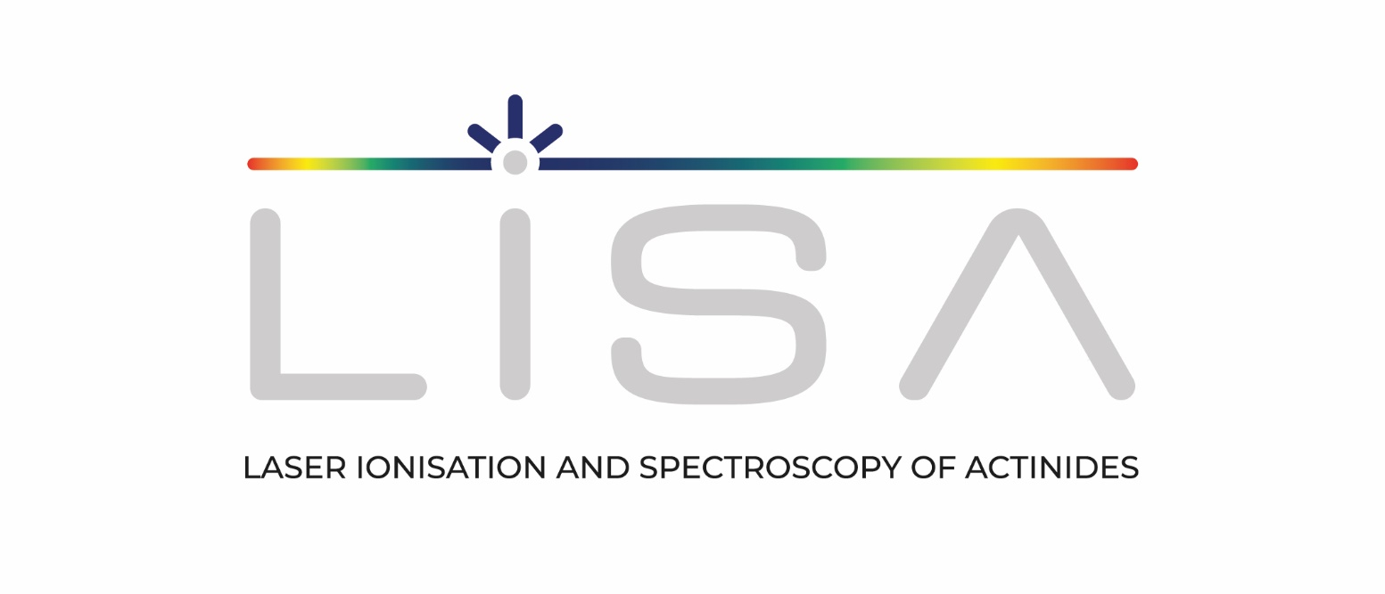

WP5: EXPLORING THE LIMITS OF NUCLEAR EXISTENCE
LISA General Training 1
V. Leask ¹, A. Raggio ², L. E. Reed ³, J. Warbinek ⁴
¹Instituut voor Kern - en Stralingsfysica, KU Leuven ²Univeristy of Jyväskylä, Departments of Physics
³Institut für Kernchemie, Johannes Gutenberg-Universität Mainz ⁴GSI Helmholtzzentrum für Schwerionenforschung GmbH
Objectives of WP5
Optimize actinide sample preparation and characterization techniques for the LISA network
Perform laser spectroscopy using highly sensitive techniques on isotopes of both actinide and trans actinide elements with the goal of probing fundamental atomic and nuclear properties and to benchmark state of the art atomic and nuclear theoretical calculations
Characterize and optimize the novel in gas jet spectroscopy technique for final implementation at GANIL S3.
Optimised actinide target preparation and characterisation
In-gas-jet resonance ionization spectroscopy
Method 1: Electrodeposition [1]
Deposition yields < 90 %
Well established
Need for baking procedure
Compound dissolved in reducing agent →Attracted to cathode → Binds to backing electrochemically
Method 2: Novel Drop-on-Demand (DoD) printing [2]
Deposition yields ≥ 97 %
Substrate on xy translation stage: position within ±2 μm
Not electrochemically bound → less stable in beam
Salt dissolved → Solution inkjet printed on backing → Solvent evaporates leaving salt on backing
5
4
3
Clean Laser
Room, ISO8
Fig. 2. DoD ²³³U target (top) and
electrodeposited ²⁴²Pu target (bottom) [3]
Fig. 3. DoD dispensing process schematic [4]
2
3
2
1
2
3
1
Fig. 6. Layout of gas-cell chamber for PLIF [6]
Fig. 5. Layout of IGLIS Laboratory at KU Leuven [6]
Fig. 1. Electrodeposition cell set-up [3]
1. Target activated by ablation laser, products carried with gas-jet of neutral gas
2. Resonance ionization takes place at intersection of lasers and gas-jet (with product)
3. Laser produced ions are confined and transported through RF Ion guides towards dipole magnet
4. Dipole magnet separates isotopes according to mass to charge ratio
5. Isotopically pure beams measured at detection station
Target characterisation techniques:
Layer homogeneity: α-spectroscopy, radiographic imaging
Deposition yields: α- or γ- spectroscopy, NAA
Layer growth mechanisms: SEM, AFM
Chemical composition: XRF, XPS
Fig. 4. Radiographic image of an
electrodeposited ²⁴²Pu target [5]
Studying the heaviest actinides
Investigation of fundamental Actinides properties at IGISOL
Limited / no information on atomic & nuclear properties
Challenging, accelerator-based production
Search for first atomic states to determine ionization potential, nuclear spin, charge radius, shape…
In-gas-cell laser
ionization [X]
Gas phase chemistry
Investigation of ionization schemes with grating Ti:Sa laser
Method for level search:
Radiation Detected-RIS
High resolution spectroscopy
of HF structure: in gas-jet technique
Production techniques:
Online -Fusion evaporation reaction
Offline -In-gas-cell Alpha-recoil source -Heated Actinides filaments
+
Lr
Filament
α-Decay
Nobelium
First states only recently determined via RADRIS
Multiple Rydberg states identified
Decay Spectroscopy
Decay modes
Lifetimes
Production yields
Silicon Detector
+
95 mbar Argon
Lawrencium
Atomic structure only known from theory
Low IP: challenging filament desorption
optimum material identified (MS21))
Fig. xx Grating-based Ti:Sa laser [X]
High resolution collinear laser Spectroscopy
Fig. X. Scheme of the RADRIS technique [x]
Hyperfine structure -nuclear spins -electromagnetic moments -mean-square charge radii
Octupole deformation in neutron-deficient Th and U
Fig. X. Experimentally investigated resonances of the 1P₁ level of different No isotopes [X]
Investigated at GSI
Theoretical predictions
Fig. xx Decay spectroscopy station
Fig. xx Collinear beamline at IGISOL [X]
Fig. X. Atomic energy levels of No and Lr [X]
References
Vascon, A. et al., Nucl. Instr. Meth. Phys. Res. Sect. A, 696, (2012), 180-191.
Haas, R. et al., Nucl. Instr. Meth. Phys. Res. Sect. A, 874, (2017), 43-49.
Düllmann, C., Actinide Sample Production At Mainz University For Applications In Chemistry And Physics Research, (2018).
BioFluidix GmbH. PipeJet P9 Nanodispenser Datasheet, 2014.
Eberhardt, K. et al., AIP Conf. Proc., 1962, (2018), 030009:1-8.
A1 Pohjalainen, I. et al., Nucl. Instr. Meth. Phys. Res. Sect. B, 376, (2016), 233-239.
A2 Tomita, H. et al., Prog. Nucl. Sci. tech. , 5 (2018).
A3 De Groote, R. P. et al. Nucl. Instr. Meth. Phys. Res. Sect. B, 463 (2020): 437-440.
This Marie Sklodowska-Curie Action (MSCA) Innovative Training Network (ITN) receives funding from the European Union H2020 Framework Programme under grant agreement no. 861198.
Notes:
***INSTRUCTIONS
Choose high-res picture, preferably dark
Replace it behind the green and blue blocks

